Slide 1
Overcurrent Circuit Protection in Harsh Environments
Oil-Resistant PPTC Devices for Factory Automation and Industrial Equipment
TE Circuit Protection
Nov 2015

Slide 2
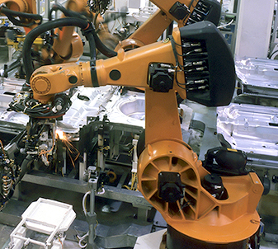
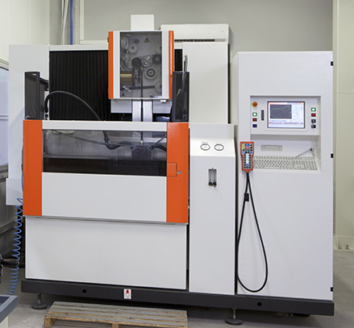
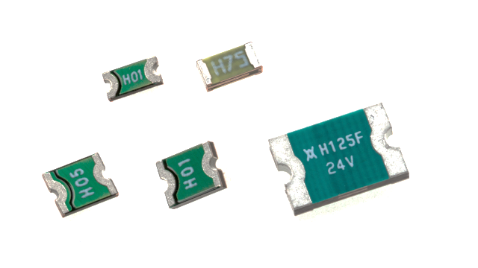
Why we developed oil-resistant PPTC devices
Oil mist or droplets occur during metal-cutting processes where cutting fluid is used for cooling or lubricating.
When oil comes into contact with hot surfaces, oil mist or droplets can form and become airborne.
The oil mist or droplets can penetrate sensitive electronics and degrade the performance or safety of circuit protection devices.
Nuisance tripping or high resistance in these devices can result in service calls or equipment down time.
Where:
Control boards for PLC / servo motor controllers
What:
Oil mist can penetrate equipment control systems
Problem:
Harsh oils can eventually degrade electronic component performance
Solution: Oil-Resistant Materials+ Resettable PPTC Devices
Resettable PPTC devices developed by TE are formulated to resist the detrimental effects of oil mist. We offer a robust, resettable safety component to reduce down time and service repair costs.

Slide 3
Typical PPTC device performance in an oil immersion test
Standard PPTC devices use polyethylene (PE) materials that have good chemical resistance characteristics, but the resin can swell when exposed to oil. When the resin swells, the resistance of the PPTC device will increase.
To solve this high-resistance issue, we use an oil-resistant resin to improve performance in harsh industrial environments where oil mist and/or droplets are present.
 | Types of Oil Tested
A | Low Flash-point Oils
B | Chlorine Based Oils
C | High Permeability Oils (Osmotic)
D | Sulfur Based Oils
E | High Alkaline Oils
A: conducted at room temperature;
B-E: soaked at 85°C/85% RH
Standard SMD PPTC Device Oil-Resistant SMD PPTC Device
Resistance increases in all oils, especially type B and E
Resistance is stable after aging in oils
Note: Users should independently evaluate the suitability of the PPTC device for use with the specific oil types that their equipment will be exposed to in actual use. Please consult TE engineering with any questions. (See last page.)

Slide 4
Oil-resistant SMD PPTC series:
Product Brief:
Oil-resistant resettable overcurrent SMD devices for industrial markets
Features:
Manufactured with oil-resistant materials
Three sizes with various voltage (6V to 30V) and hold current ratings (0.1A – 1.25A)
Products meet applicable industry standards
Benefits:
Stable performance when exposed to oil mist and/or droplets
Devices compatible with high-volume electronic assembly
RoHS compliant and halogen free
Target Industry Segment
Factory automation equipment
Machine tools
Industrial robots: robotic drilling or cutting
TE Product Specification:
Available on
  www.TE.com
  www.circuitprotection.com

Slide 5
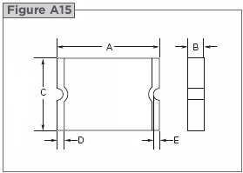
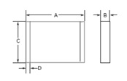
Oil-resistant SMD PPTC series specifications
Part Description | Case size | Voltage (Vdc) | Hold Current @ 25°C | Temperature Range
nanoSMDCH010F | 3216 (1206) | 30V | 0.10A | -40°C~125°C
nanoSMDH075F | 3216 (1206) | 6V | 0.75A | -40°C~125°C
microSMDCH010F | 3225 (1210) | 30V | 0.10A | -40°C~125°C
microSMDCH050F | 3225 (1210) | 6V | 0.50A | -40°C~125°C
SMDCH125F/24 | 7555 (2920) | 24V | 1.25A | -40°C~125°C
Additional products with different voltage and current rating can be developed upon request
Product Dimensions
Part Description | A |  | B |  | C |  | D |  | E
 | Min. | Max. | Min. | Max. | Min. | Max. | Min. | Max. | Min.
nanoSMDCH010F | 3.00 | 3.40 | 0.30 | 0.70 | 1.37 | 1.80 | 0.25 | 0.75 | 0.076
nanoSMDH075F | 3.00 | 3.40 | 0.60 | 1.00 | 1.40 | 1.80 | 0.20 | 0.80 | -
microSMDCH010F | 3.00 | 3.43 | 0.57 | 0.97 | 2.35 | 2.80 | 0.25 | 0.75 | 0.076
microSMDCH050F | 3.00 | 3.43 | 0.24 | 0.64 | 2.35 | 2.80 | 0.25 | 0.75 | 0.076
SMDCH125F/24 | 7.30 | 7.70 | 0.90 | 1.40 | 4.90 | 5.30 | 0.95 | 1.45 | 0.35
All parts except
nanoSMDH075F
nanoSMDH075F
Note:
Users should independently evaluate the suitability of the devices for use with the specific oil type used in their equipment and applications. Please consult TE engineering with any questions.
Contact TE representatives for your specific electrical and dimensional design requirements. (See last page.)

Slide 6
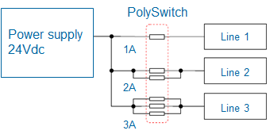
Application example
Application: Robotic drill machine
Part Number(s): SMDCH125F/24-02
Functional Area: 24V power supply line
Protection Type: Overcurrent
Requirements:
  Replacing alarm fuse
  Voltage rating: more than 24Vdc
  Ih current: 1A@60℃
  Cutting oil resistance (customer to provide）
  SMD device
  UL approved
CPD Advantage:
  Develop oil-resistant SMD device
7.5 x 5.1 mm

Slide 7
Ordering information
Part Description | TE Part Number | SPQ | MOQ
nanoSMDCH010F-02 | RF1514-000 | 4000 | 20000
nanoSMDH075F-02 | RF1604-000 | 3000 | 15000
microSMDCH010F-02 | RF1515-000 | 3000 | 15000
microSMDCH050F-02 | RF1605-000 | 4000 | 20000
SMDCH125F/24-02 | RF4432-000 | 3000 | 15000
All products are RoHS complaint and halogen free
7

Slide 8
For More Information
TE Circuit Protection
306 Constitution Drive Menlo Park, CA USA 94025-1164
Tel : (800) 227-7040, (650) 361-6900
Fax : (650) 361-4600
www.circuitprotection.com
www.circuitprotection.com.cn (Chinese)
www.te.com/japan/bu/circuitprotection/ (Japanese)
Brazil
Tel : 55-21-3958-0937
Email: Genaro.Maldonado@te.com
Korea
Tel : 82-2-3415-4656
Fax : 82-2-3486-1786
Email: bk.park@te.com
China
Tel : 86-755-2547-3060
Fax : 86-755-2598-0419
Email: teddy.zhao@te.com
France / Italy / Iberia / Greece / Turkey / UK / Eire / Benelux / Israel / South Africa
Tel : 33-1-34208455
Fax : 33-1-34208479
Email: contact_emea_cpd@te.com
Japan
Tel : 81-44-844-8194
Fax : 81-44-844-8040
Email: jpnpoly@te.com
South Asia
Tel : 60-4-810-2112
Mobile: 60-19-472-5628
Fax : 60-4-6433288
Email: patrick.wong@te.com
Germany / Austria / Switzerland / Eastern Europe / Russia / Nordic / Baltic / Others
Tel : 49-89-6089485
Fax : 49-89-6089394
Email: contact_emea_cpd@te.com
Taiwan
Tel : 886-2-2171-5288
Fax : 886-2-8768-1277
Email: murray.huang@te.com
India
Tel : 91-80-2854-0800
Mobile: 91-77-6051-3140
Email: haribabu@te.com
8

