Slide 1
MEAS – Betatherm Ireland Ltd GENDER PAY GAP REPORT 2025
PUBLISHED DECEMBER 2025

Slide 2

WHAT IS GENDER PAY GAP REPORTING?
As one of our key values, TE Connectivity compensates its employees fairly and equitably based on performance, with equal pay for equal work. We maintain robust policies and practices reinforcing our commitment, including analyses from outside experts, with oversight from our Board and senior leaders.
Mandatory gender pay gap (GPG) reporting in Ireland is now in its fourth year. The Gender Pay Gap Information Act of 2021 amended the Employment Equality Act 1998 and focuses not on pay equity but represents an aggregate view of all employees in the Company.
This law changed this year to requires employers with 50 or more employees to examine and publish their gender pay and participation gaps.
Closing the overall gender pay gap is different to ensuring equal pay for equal work. It involves making sure that men and women are represented at all levels throughout the Company, particularly in leadership roles which tend to carry higher market rates of pay. At TE Connectivity, we are committed to taking steps to ensure that we are attracting, hiring and promoting diverse talent throughout the Company, so we can make progress towards closing the representation gap which is reflected in the pay report.
PAY EQUITY
Compares the pay between men and women doing equal jobs with similar experience, skills, and performance
MEAN PAY GAP
Compares the average pay between men and women across the Company
MEDIAN PAY GAP
Compares the earnings of the middle employee for one group (e.g., men) to the middle earner in another group (e.g., women) across the Company.
2
Ireland Gender Pay Gap Report 2025

Slide 3


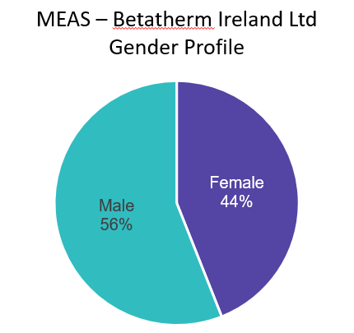





WE ARE PROUD OF OUR EMPLOYEEES For the 2025 MEAS – Betatherm Ireland Ltd. Gender Pay Gap reporting period (the 12-month period immediately preceding the June 30, 2025 snapshot) there were 50 employees in the MEAS – Betatherm Ireland Limited entity. Our employees work in either our Galway site, Cork office space or remotely from home. Our employees in Ireland work in 12 different job functions ranging from Manufacturing, Engineering and Technology, Facilities, Logistics, Finance and Accounting, Human Resources, Marketing, IT, Continuous Improvement, Procurement, Quality and Sales.
OUR WORKFORCE AT-A-GLANCE
2025
EMPLOYEES
50
JOB FUNCTIONS
12
SITES
1
OUR DATA AT-A-GLANCE
HOURLY EARNINGS
30 June 2025
BONUS EARNINGS
12-MONTH PERIOD
Ireland Gender Pay Gap Report 2025
3

Slide 4

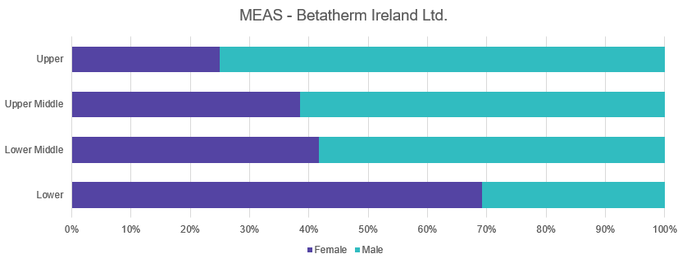

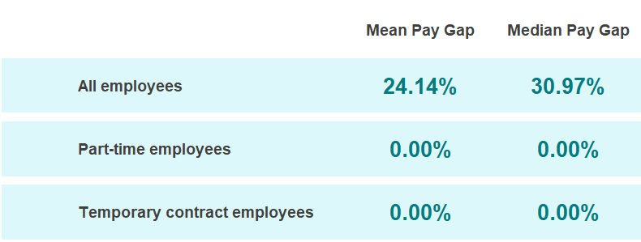
What is it? The gender pay gap shows the difference between the hourly earnings (including base pay, bonuses, and other covered allowances) of men and women employed by the Company in June 2025. A gender pay gap can be caused by several factors including the under-representation of women in senior positions in the Company. It is important to note that this is different to the issue of equal pay, which is the legal requirement to pay men and women the same for equal work. The result of MEAS – Betatherm Ireland Ltd. review of equal pay for equal work showed no marked gaps in base pay.
GENDER PAY GAP REPORTING
PAY QUARTILES
What are they? The Pay Quartiles show the percentage of men and women in each pay quartile, as an aggregate, across the Company.
 | 2025
MEAN | 24.14%
MEDIAN | 30.97%
Ireland Gender Pay Gap Report 2025
4

Slide 5
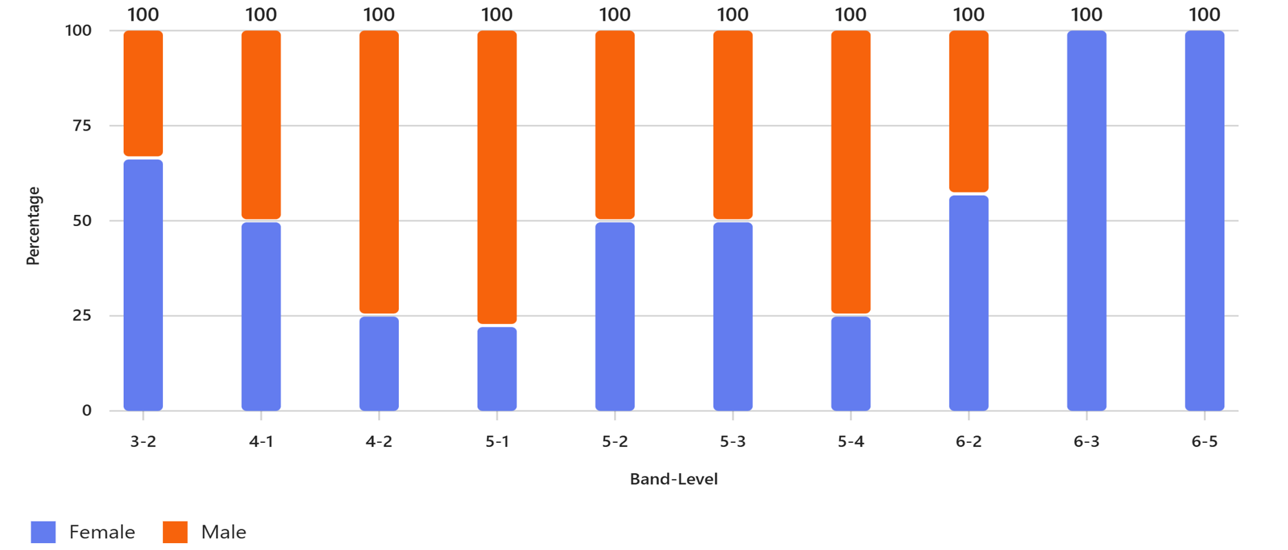
A DEEPER LOOK AT REPRESENTATION, BY LEVEL
PERCENTAGE OF MEN AND WOMEN BY LEVEL
As we noted, the hourly pay and quartile differences are primarily due to the numbers of women representatives in senior and leadership roles. During this reporting period, women comprised 44% of all the Company employees. We are actively working to recruit, hire and further develop more women in leadership roles and to make the Company an attractive place for women to work.
Also, middle management and senior professional staff have only 33% female representation. Below are some of the steps we have taken, where legally permissible, to drive gender diversity across the Company:
Inclusion Workshops available to all employees
Scorecards with business-relevant diversity metrics to drive accountability
Inclusive leadership and mitigation of bias reinforced in all talent processes

Slide 6
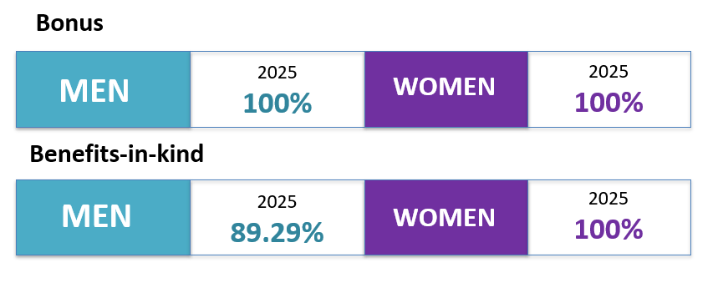
What is it? The percentage of men and women who received a bonus and benefits-in-kind during the 12-month period leading up to 30 June 2025.
BONUS PARTICIPATION
BONUS DIFFERENCES
What is it? The percentage difference in bonus received by men and women during the 12-month period leading up to 30 June 2025, as a percentage of the bonus received by men.
 |  | 2025
MEAN |  | 18.60%
 |  | 2025
MEDIAN |  | 40.03%
The median and mean bonus pay gap are the result of women being more highly represented in production, assembly and administrative functions in a Business Unit that has underperformed. These roles attract lower variable pay due to both their position within lower pay bands and the weaker performance of the BU. In contrast, men are over-represented in senior positions where the bonus/incentive component is a more significant lever of the total compensation package and in Business Units that have delivered stronger results.
Our bonus plans are open to all.
All men and women in the Company are eligible to participate in one of the global bonus schemes, if they are employed by the threshold date and are meeting performance expectations to receive a bonus payment.
The difference above is due to new entrants joining the Company after the threshold date.
Ireland Gender Pay Gap Report 2025
6

Slide 7

Our commitment to a proactive and strategic approach to preventing pay disparities includes:
1
2
Continuous Reviews:
We constantly monitor our pay practices, job classifications, and performance and talent management processes to ensure that all employees are paid fairly and competitively.
Third-party Expertise:
We engage unbiased experts to conduct pay equity analyses, to keep pace with the ever-evolving regulatory landscape and industry best practices, as well as ensure that our methodologies align with the latest accepted standards.
PAY TRANSPARENCY AND EQUITY
At the Company and across TE Connectivity, we view pay transparency and pay equity as critical aspects of an inclusive and equitable work environment.
As part of our dedication to both, we regularly publish pay gap reports in various countries where we operate, including but not limited to the United Kingdom, Ireland, Japan, and France. These reports help emphasize our commitment to pay transparency and provide us an opportunity to highlight our progress from year to year.
We also invest our resources in creating a workplace that is fair, inclusive, and accurately values every individual’s contribution.
Our compensation programs and policies are thoughtfully designed to ensure both competitive and equitable pay, grounded in the responsibilities of individual roles, company performance, and individual achievements—and agnostic of gender, race, ethnicity, or other individual demographics.
3
4
Addressing Disparities:
We are deeply committed to addressing the underlying root causes of pay gaps, so that we can take swift and decisive action to rectify any disparities when they are identified.
Prevention Mechanisms:
Our primary objective is to have policies and programs in place that prevent pay inequities from arising in the first place. Continuous reviews of our processes help, but so do unbiased performance evaluation practices, as well as ongoing diversity and inclusion training.
‘Accelerate Action’— the TE Connectivity theme at International Women’s Day 2025
Ireland Gender Pay Gap Report 2025

Slide 8

Pay equity compares the pay of men and women who are peers considering factors like career band and level, location, tenure, performance, and experience. TE Connectivity routinely analyses pay to ensure equity. As detailed earlier – the results of our 2025 Enterprise review of equal pay for equal work showed no marked gaps in base pay, target total direct compensation, and actual total direct compensation . We continue to focus on how we can increase opportunities for all employees to advance their careers. In tandem, these efforts will strengthen our culture of trust and transparency at the Company and across TE Connectivity.
OUR COMMITMENT SHOWS IN OUR PAY EQUITY RESULTS
To advance our commitment to pay equity, we’re partnering with Syndio, the leading workplace equity technology platform, to measure pay equity.
8
Ireland Gender Pay Gap Report 2025

Slide 9
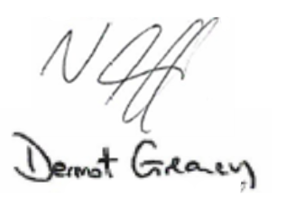
MEAS – Betatherm Ireland Ltd., a TE Connectivity Company employs more than 50 employees in Ireland. Under the regulations we are required to report our Gender pay Gap for this entity.
GENDER PAY GAP STATUTORY DISCLOSURE
 | GENDER PAY GAP | BONUS | BONUS PARTICIPATION | PART-TIME | TEMPORARY
MEDIAN 2025 | 24.14% | 18.60% | 100% | N/A | N/A
MEAN 2025 | 30.97% | 40.03% | 100% | N/A | N/A
Declaration
I confirm that the Company’s 2025 gender pay gap calculations are accurate and meet the requirements of the regulations.
Signature Neil Griffin - Operations Manager
Dermot Greaney – Finance Controller
Ireland Gender Pay Gap Report 2025
9

Slide 10

You
Belong
Here
TE Connectivity Ireland, MEAS – Betatherm Ireland Ltd.
Gender Pay Gap Report – 2025
DIVERSITY
ENGAGEMENT
INCLUSION

