Slide 1
CREGANNA MEDICAL IRELAND
GENDER PAY GAP REPORT
2025
PUBLISHED NOVEMBER 2025

Slide 2

A MESSAGE FROM JEAN O’LEARY
TE MEDICAL HR LEADER
At TE Medical, our people are the foundation of our success. We are committed to building a workplace where everyone feels valued, supported, and empowered to thrive, with fair and competitive compensation at its core.
Our inclusion and diversity strategy is built on four key pillars:
Employee Experience: Embedding inclusion throughout the employee journey.
Employer Brand: Attracting and developing diverse talent to drive innovation.
Community Impact: Making a difference through local partnerships and engagement.
Business Partnership: Expanding our diverse supplier network and inclusive practices.
These pillars shape a culture where equity and belonging drive progress. This year’s 2025 Ireland Gender Pay Gap Report highlights our continued focus on pay transparency and equity, supported by our partnership with Syndio, which ensures robust analysis and accountability.
We are proud of the progress made, yet remain focused on advancing representation and equity across every level of our organisation—creating a workplace where everyone truly belongs.
Ireland Gender Pay Gap Report 2025
2

Slide 3

WHAT IS GENDER PAY GAP REPORTING?
As one of our key values, TE Connectivity compensates its employees fairly and equitably based on performance, with equal pay for equal work. We maintain robust policies and practices reinforcing our commitment, including analyses from outside experts, with oversight from our Board and senior leaders.
Mandatory gender pay gap (GPG) reporting in Ireland is now in its fourth year. The Gender Pay Gap Information Act of 2021 amended the Employment Equality Act 1998 and focuses not on pay equity but represents an aggregate view of all employees in the Company.
This law changed this year to requires employers with 50 or more employees to examine and publish their gender pay and participation gaps.
Closing the overall gender pay gap is different to ensuring equal pay for equal work. It involves making sure that men and women are represented at all levels throughout the Company, particularly in leadership roles which tend to carry higher market rates of pay. At TE Connectivity, we are committed to taking steps to ensure that we are attracting, hiring and promoting diverse talent throughout the Company, so we can make progress towards closing the representation gap which is reflected in the pay report.
PAY EQUITY
Compares the pay between men and women doing equal jobs with similar experience, skills, and performance
MEAN PAY GAP
Compares the average pay between men and women across the Company
MEDIAN PAY GAP
Compares the earnings of the middle employee for one group (e.g., men) to the middle earner in another group (e.g., women) across the Company.
3
Ireland Gender Pay Gap Report 2025

Slide 4


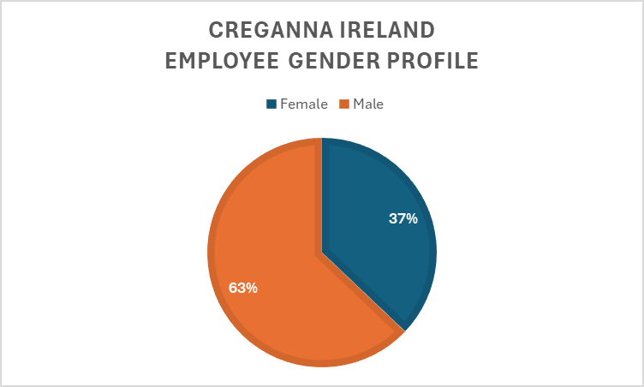





WE ARE PROUD OF OUR EMPLOYEEES
For the 2025 Creganna Unlimited Gender Pay Gap reporting period (the 12-month period immediately preceding the June 30, 2025, snapshot) there were 1,089 employees in the Creganna Unlimited legal entity. Our employees work across 5 buildings in one manufacturing site or remotely from home. Our employees work in 17 different job functions ranging from Manufacturing, to Engineering and Technology, Manufacturing, Continuous Improvement, Quality, Facilities, Project Management, Purchasing and Supply Chain roles.
OUR WORKFORCE AT-A-GLANCE
2025
EMPLOYEES
1,089
JOB FUNCTIONS
17
SITES
1
OUR DATA AT-A-GLANCE
HOURLY EARNINGS
30 June 2025
BONUS EARNINGS
12-MONTH PERIOD
Ireland Gender Pay Gap Report 2025
4

Slide 5
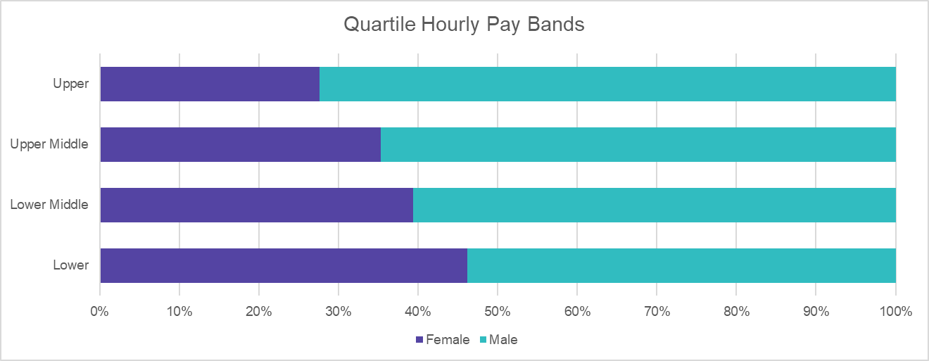

What is it?
The gender pay gap shows the difference between the hourly earnings (including base pay, bonuses, and other covered allowances) of men and women employed by the Company in June 2025. A gender pay gap can be caused by several factors including the under-representation of women in senior positions in the Company.
It is important to note that this is different to the issue of equal pay, which is the legal requirement to pay men and women the same for equal work.
While the mean gender pay gap has reduced since 2024, indicating progress at senior and higher-paid levels, the median gap has widened slightly, suggesting the need to strengthen equity and progression across the middle of the organization. This reinforces the importance of targeted interventions in development, promotion, and reward practices to ensure fair progression opportunities for all employees.
GENDER PAY GAP REPORTING
PAY QUARTILES
What are they?
The Pay Quartiles show the percentage of men and women in each pay quartile, as an aggregate, across the Company.
2024
2025
% difference
-
 | Mean | Median
All employees | 11.40% | 6.56%
Part-time employees | -6.92% | -4.46%
Temporary contract employees | -21.58% | -22.42%
MEAN
12.61%
11.40%
1.21
-
MEDIAN
6.56%
5.11%
1.45
Ireland Gender Pay Gap Report 2023
5

Slide 6
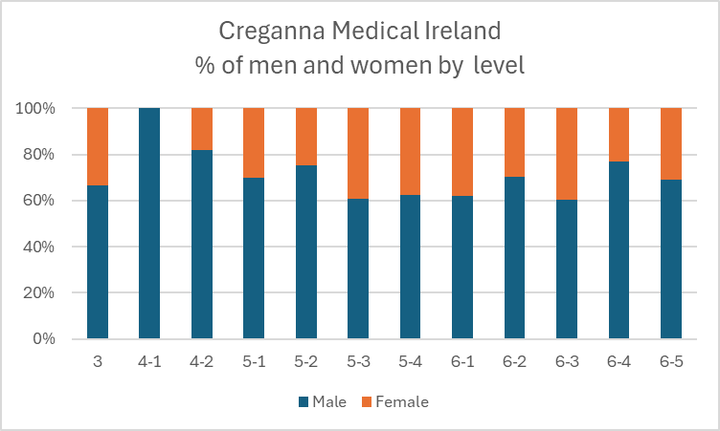
A DEEPER LOOK AT REPRESENTATION, BY LEVEL
PERCENTAGE OF MEN AND WOMEN BY LEVEL – Creganna Medical Ireland
As we noted, the hourly pay and quartile differences are primarily due to the numbers of women in senior and leadership roles. During this reporting period, women comprised 37% of all the Company employees and 18% of senior leadership positions – representing an increase of 5% from 2024.
Middle management has 26% female representation and professional staff has 39% female representation. We have increased female talent pipeline and will continue this focus on nurturing diverse talent at graduate and entry level. In addition, we have implemented a Panel of talent for supervisory/middle management roles to better position for future roles. In addition, below are some of the steps we have taken, where legally permissible, to drive gender diversity across the Company: :
Fixed Pay Rate Structure for Production and Warehouse roles implemented
Inclusion Workshops available to all employees
Inclusion training as part of Supervisor Development Programme mandatory for Supervisors
Increased female representation at Graduate and Apprentice levels
Scorecards with business-relevant diversity metrics to drive accountability
Inclusive leadership and mitigation of bias reinforced in all talent processes
Network of Female High Potential Talent established and hosted by Senior Leadership
Ignite Programme – designed for female talent at all levels. We will expand the “Ignite” and Female High Potential programmes to mid-level technical roles and track promotion velocity by gender.
Ireland Gender Pay Gap Report 2025

Slide 7
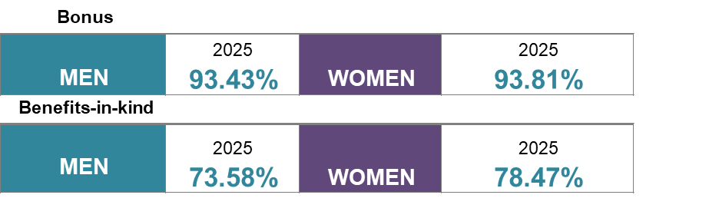
What is it?
The percentage of men and women who received a bonus and benefits-in-kind during the 12-month period leading up to 30 June 2025.
BONUS PARTICIPATION
BONUS DIFFERENCES
What is it?
The percentage difference in bonus received by men and women during the 12-month period leading up to 30 June 2025, as a percentage of the bonus received by men.
 |  | 2024 | 2025 | Difference
MEAN |  | 12.98% | 7.54% | -5.44%
 |  | 2024 | 2025 | Difference
MEDIAN |  | 1.26% | 0.35% | -0.91%
The Median bonus pay gap is negligible and has improved year on year. The mean bonus gap is higher and favours men. This is the result of more men being employed in senior positions, where the bonus/incentive component is a more significant lever of the total compensation package.
Our bonus plans are open to all.
All men and women in the Company are eligible to participate in one of the global bonus schemes, if they are employed by the threshold date and are meeting performance expectations to receive a bonus payment.
Ireland Gender Pay Gap Report 2025
7

Slide 8





Our commitment to a proactive and strategic approach to preventing pay disparities includes:
1
2
Continuous Reviews:
We constantly monitor our pay practices, job classifications, and performance and talent management processes to ensure that all employees are paid fairly and competitively.
Third-party Expertise:
We engage unbiased experts to conduct pay equity analyses, to keep pace with the ever-evolving regulatory landscape and industry best practices, as well as ensure that our methodologies align with the latest accepted standards.
PAY TRANSPARENCY AND EQUITY
At the Company and across TE Connectivity, we view pay transparency and pay equity as critical aspects of an inclusive and equitable work environment.
As part of our dedication to both, we regularly publish pay gap reports in various countries where we operate, including but not limited to the United Kingdom, Ireland, Japan, and France. These reports help emphasize our commitment to pay transparency and provide us an opportunity to highlight our progress from year to year.
We also invest our resources in creating a workplace that is fair, inclusive, and accurately values every individual’s contribution.
Our compensation programs and policies are thoughtfully designed to ensure both competitive and equitable pay, grounded in the responsibilities of individual roles, company performance, and individual achievements—and agnostic of gender, race, ethnicity, or other individual demographics.
3
4
Addressing Disparities:
We are deeply committed to addressing the underlying root causes of pay gaps, so that we can take swift and decisive action to rectify any disparities when they are identified.
Prevention Mechanisms:
Our primary objective is to have policies and programs in place that prevent pay inequities from arising in the first place. Continuous reviews of our processes help, but so do unbiased performance evaluation practices, as well as ongoing diversity and inclusion training.
TE team members posing to ‘Embrace Equity’
Ireland Gender Pay Gap Report 2025

Slide 9

Pay equity compares the pay of men and women who are peers considering factors like career band and level, location, tenure, performance, and experience.
TE Connectivity routinely analyses pay to ensure equity. As detailed earlier – the results of our 2025 Enterprise review of equal pay for equal work showed no marked gaps in base pay, target total direct compensation, and actual total direct compensation .
We continue to focus on how we can increase opportunities for all employees to advance their careers. In tandem, these efforts will strengthen our culture of trust and transparency at the Company and across TE Connectivity.
OUR COMMITMENT SHOWS IN OUR PAY EQUITY RESULTS
To advance our commitment to pay equity, we’re partnering with Syndio, the leading workplace equity technology platform, to measure pay equity. We are proud that our 2025 results remain consistent with our results in 2024, which also reflected no marked gaps in base pay, target total direct compensation, and actual total direct compensation.
9
Ireland Gender Pay Gap Report 2025

Slide 10

Creganna Medical Ireland, a TE Connectivity Company employs more than 1,089 employees in Ireland. Under the regulations we are required to report our Gender pay Gap for this entity.
GENDER PAY GAP STATUTORY DISCLOSURE
 | GENDER PAY GAP | BONUS | BONUS PARTICIPATION | PART-TIME | TEMPORARY
MEDIAN 2025 | 6.56% | 7.54% | 93.43% Male | -4.46% | -22.42%
MEAN 2025 | 11.40% | 0.35% | 93.81% Female | -6.92% | - 21.58%
Declaration
I confirm that the Company’s 2025 gender pay gap calculations are accurate and meet the requirements of the regulations.
Signature Paul Horan – VP, Finance
Ireland Gender Pay Gap Report 2025
10

Slide 11

You
Belong
Here
TE Connectivity Ireland - Creganna Medical Ireland
Gender Pay Gap Report – 2025
DIVERSITY
ENGAGEMENT
INCLUSION

