Slide 1
Tubing Overview

Slide 2

Automotive Tubing
_{Dry splice sealing,}
_{strain relief: RPPM}
Protection for wire bundles, terminals, dry splices, strain relief, single wall tubing :
LSTT, CGPT, RNF, RPT-120 CRN, RW-175, RW-200,
For sealed applications
Sealing and protection for wire bundles, connectors, terminals and splices: HTAT, ATUM
Grommet and wire bundle sealing: RayBlock family
Hose and wire bundle abrasion protection: HFT5000 family
Safety applications – for assy and
de-assy short circuit bar to
remove static
_{Ring terminal sealing:}
_{RBK-RTP-125}
Brake and air
conditioning line
protection: AP2000
_{Stub splice sealing:}
_{ES Cap family}
_{Hose and pipe protection: DWTC}
In-line splice sealing products: QSZH, RBK-ILS, RBK-VWS, SCT families

Slide 3
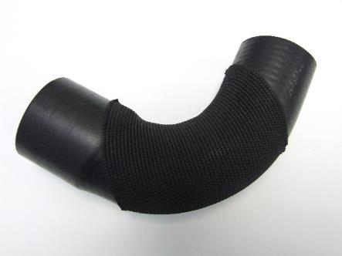
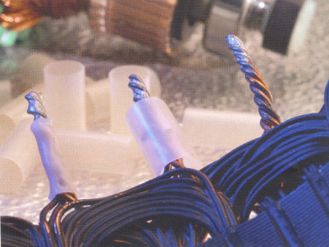
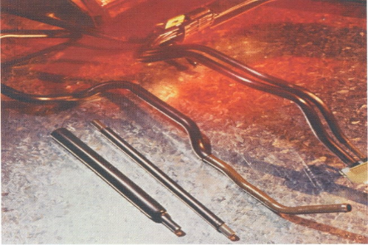
Tubing product overview
Wide product range of heat shrinkable products
  Sealing
  Insulation
  Protection
  Beautification
  Identification
Secondary locking area
Closed box

Slide 4
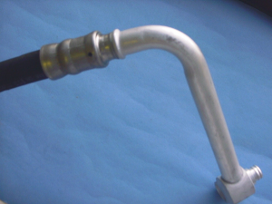
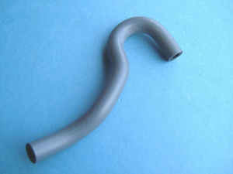
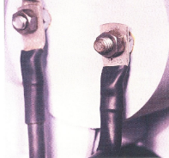
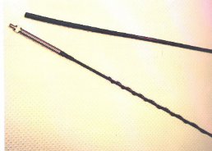
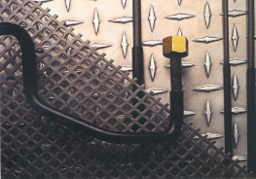
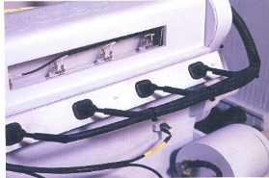
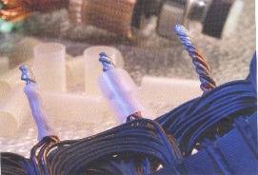
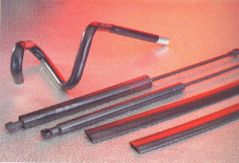
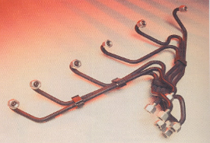

Product applications
Air Conditioning
Pipes
Hoses
Power Cables
Car Antennas
Power Steering lines
Wire Protection
Alternator Windings
Cosmetic
Fuel Injection
Clusters
Brake Pipes

Slide 5
Sealing Applications

Slide 6
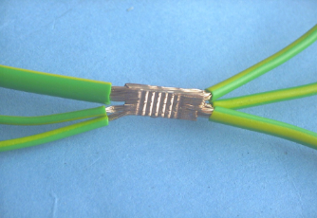
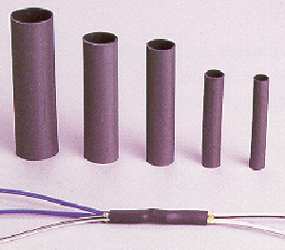
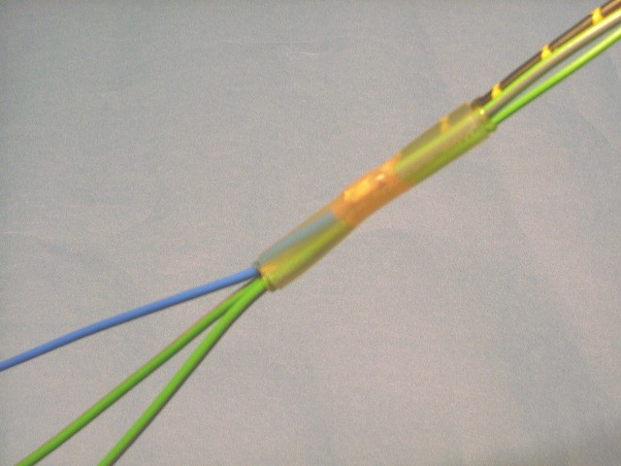
Splice applications
QSZH
  Replacement for RBK
  Installation benefits
  Zero halogen
  Watertight seal
  High shrink ratio 4:1 enables one size tube to protect many splice configurations
RBK
  VWS – clear product
  ILS – black product
  Watertight seal
  High shrink ratio 4:1 enables one size tube to protect many splice configurations

Slide 7



Splice applications
RPPM
  Splash proof
  Used for protecting wire splices and other substrates
  Fast to install – 6 seconds average
  High shrink ratio 4:1 enables one size tube to protect many splice configurations
  Used where conventional splice taping is considered inadequate
  Miniature splices

Slide 8
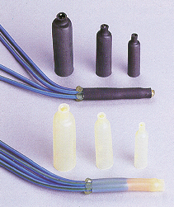


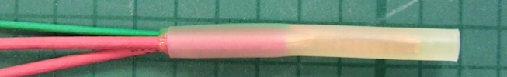
Splice applications
ES Caps (end splice)
  Mechanical and Insulation protection
  Clear and black versions
  3 sizes cover many splice configurations
  Heavy wall available
  Watertight seal

Slide 9
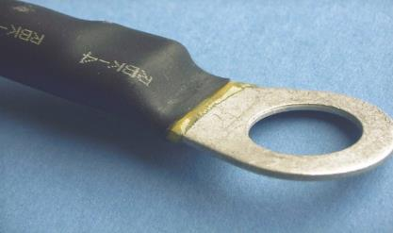
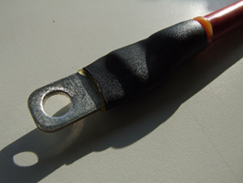
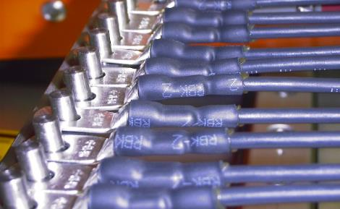
Ring Terminal applications
RBK, QSZH, ATUM, CGPT, RTP < 150° C
  Mechanical and Insulation protection
  Sealing (not CGPT)
  Ability to seal depends upon ring terminal geometry
  SCT @ 150 °C

Slide 10
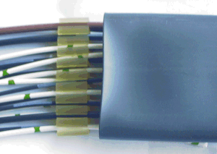
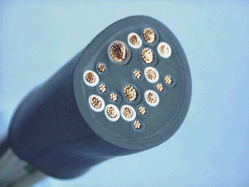
Wire Bundle Sealing applications
RBK-85 (85 °C) and RBK-105 (105 °C)
  Seals up to 20 wires
  Provides strain relief and noise reduction
  Low profile
  Combines hot melt adhesive profiles with heat shrink tubing
  Watertight seal

Slide 11

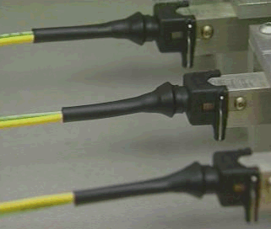
Connector applications
HTAT, ATUM, CGPT, LSTT < 150 °C
  Sealing (HTAT and ATUM) and strain relief the back of a connector
  High shrink ratio available to fit over large connectors
  Niche applications
SCT @ 150 °C

Slide 12
Summary of Automotive Sealing Applications & Products
 | PRODUCTS
APPLICATION | QSZH | RBK-ILS | RBK-VWS | ES-CAP | SCT | RBK-RTP | HTAT | RBK-105-KIT | RBK-85-KIT
Splice Sealing - Inline | √ | √ | √ |  | √
Splice Sealing - Stub |  |  |  | √
Ring Terminal Sealing | √ | √ | √ |  | √ | √
Connector Sealing |  |  |  |  | √ |  | √
Bundle Wire Sealing |  |  |  |  |  |  |  | √ | √

Slide 13
Hose & Pipe Applications

Slide 14
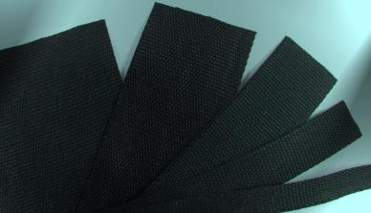
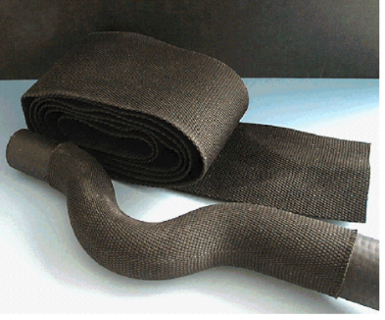
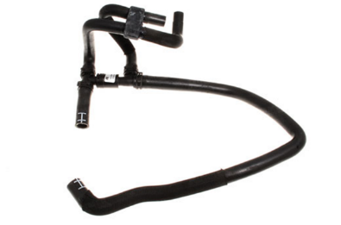
Hose & Pipe applications
HFT5000 (Heat shrink Fabric Tubing)
  Hose protection
  Abrasion resistant
  Flexible
  Simple installation
  Halogen Free
  2:1 heat shrink ratio
  Breathable, no fluid entrapment
  Noise suppression
  Stays in place

Slide 15
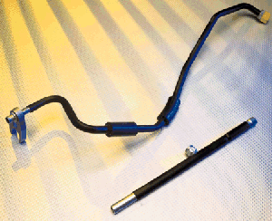
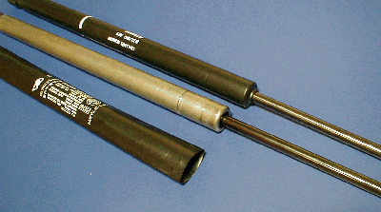

Pipe applications
AP2000, DWTC, HFT5000,
CGPT, LSTT, RPT
  Pipe protection
  Cosmetics
  Replace paint
  Abrasion protection (plastic pipe)

Slide 16
Other Applications

Slide 17
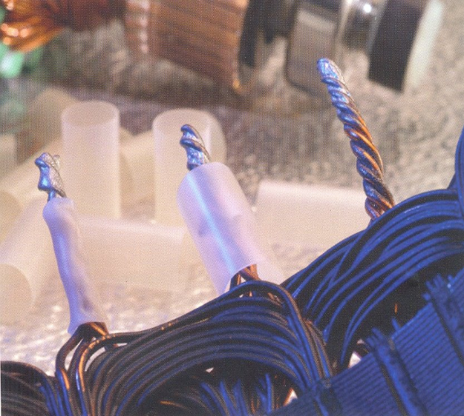
High Temperature and
Aggressive Fluid applications
RBK, QSZH, ATUM, CGPT, RTP
  Mechanical and Insulation protection
  Sealing (not CGPT)
  Ability to seal depends upon ring
  terminal geometry

Slide 18
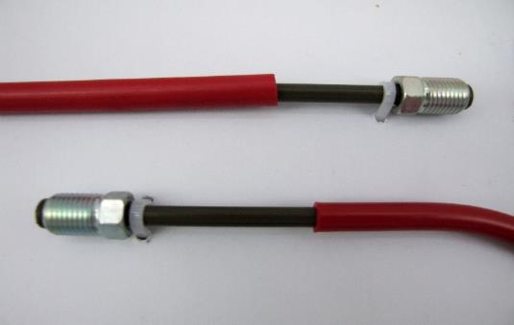
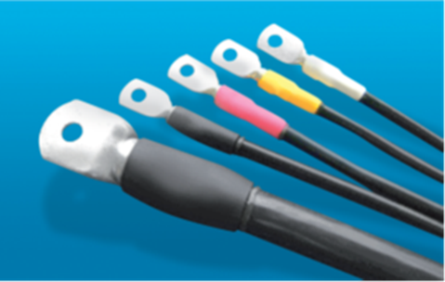
Identification applications
RBK, QSZH, ATUM, CGPT, RTP
  CGPT / LSTT single wall
  Wide range of colours available
  RBK-RTP dual wall adhesive lined
  DCPT green yellow single wall

Slide 19
TE Connectivity, TE and TE connectivity (logo), EVERY CONNECTION COUNTS, RBK, ATUM, QSZH are trademarks.
© 2015 TE Connectivity
About TE Connectivity
TE Connectivity (NYSE: TEL) is a $14 billion global technology leader. Our connectivity and sensor solutions are essential in today’s increasingly connected world. We collaborate with engineers to transform their concepts into creations – redefining what’s possible using intelligent, efficient and high-performing TE products and solutions proven in harsh environments. Our 80,000 people, including 7,500 design engineers, partner with customers in over 150 countries across a wide range of industries. We believe EVERY CONNECTION COUNTS – www.TE.com.
While TE Connectivity (TE) has made every reasonable effort to ensure the accuracy of the information in this presentation, TE does not guarantee that it is error-free, nor does TE make any other representation, warranty or guarantee that the information is accurate, correct, reliable or current. TE reserves the right to make any adjustments to the information contained herein at any time without notice. TE expressly disclaims all implied warranties regarding the information contained herein, including, but not limited to, any implied warranties of merchantability or fitness for a particular purpose. The dimensions in this article are for reference purposes only and are subject to change without notice. Specifications are subject to change without notice. Consult TE for the latest dimensions and design specifications.

Slide 20
EVERY CONNECTION COUNTS
www.TE.com

